Slide 1
PHYSIOTHERAPY exercise reminder
BY B. Suma Durga

Slide 2
AGENDA
AIM
MOTIVE
MODULES
CHALLANGES
CODE

Slide 3
AIM
THE PRIMARY AIM OF THIS PYTHON PROJECT IS TO REMIND THE PATIENTS ABOUT THEIR DAILY EXERCISE ROUTINE AND PROVIDE A CUE ON THE EXERCISES BY ALERTING THEM WITH THE COMPLETION OF EACH EXERCISE.

Slide 4
MOTIVE
DURING PANDEMIC CONDITIONS LIKE COVID IT IS DIFFICULT FOR PEOPLE TO HAVE DIRECT CONSULATION WITH THE PHYSICIANS AND IT IS TOO TOUGH ESPECIALLY FOR A PHYSIOTHERAPIST AND PATIENT TO COME IN DIRECT CONTACT WITH EACH OTHER.SO USING THIS KIND OF DIGITAL APPLICATIONS WILL HELP.

Slide 5
MODULES
1.TIME
2.TKINTER
3.OS
4.WAVE
5.PYAUDIO

Slide 6
CHALLANGES

Slide 7
The challenges I faced is to insert audio in the program using pyaudio module.

Slide 8
CODE

Slide 9
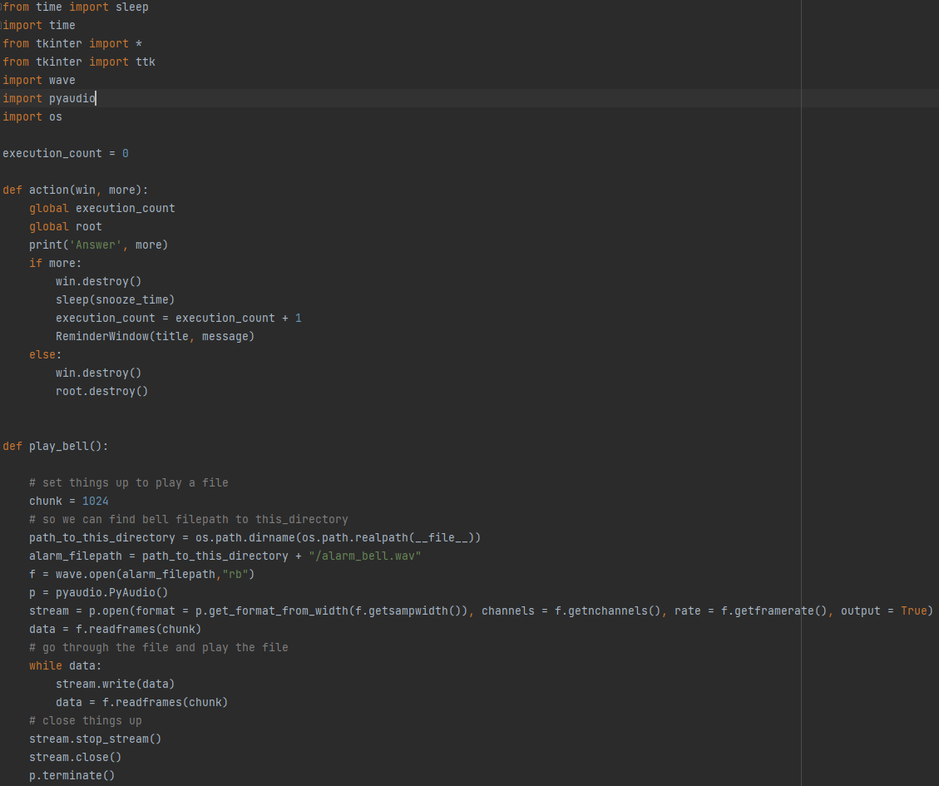

Slide 10
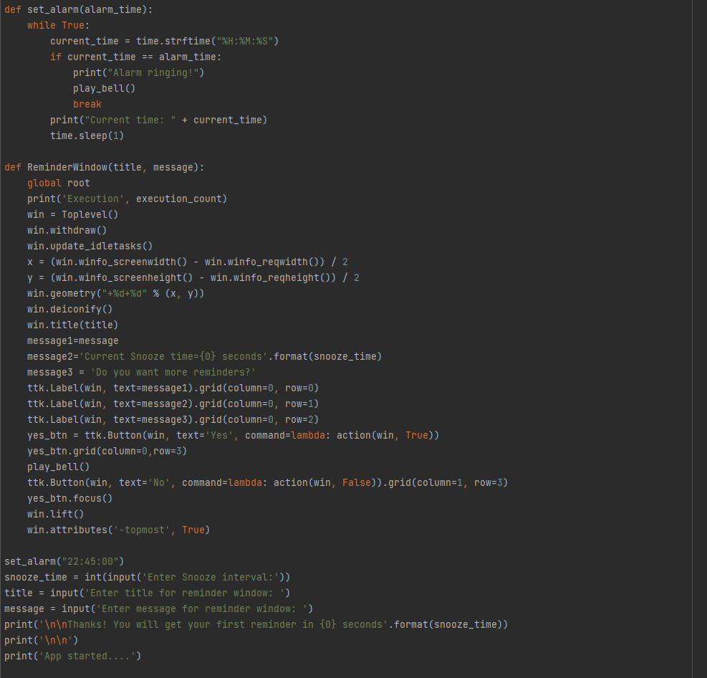

Slide 11
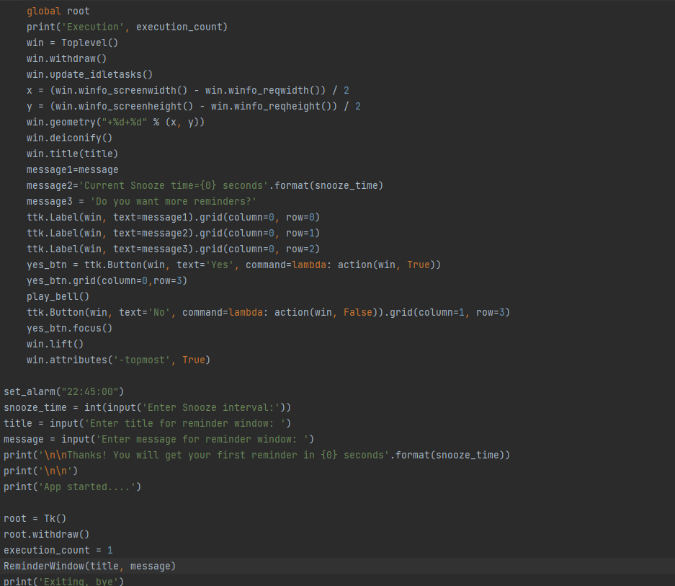

Slide 12
THANK YOU

